Slide 1
Chapter 9. B-Tree and B+Tree
Problem:
  Develop an efficient index file
Solution
  Balanced, Paged binary search tree
Performance
  Problem solved
Improvement
  B+Tree

Slide 2
Binary Search Tree
Consider an example of binary search of a sorting list
ax cl de fb ft hn jd kf nr pa rf sd tk ws yj
Binary search is effective but the sorting is too expensive.
Q: Is sorting necessary for binary search?
The answer is No.
Because the purpose of sorting is to find the central item
in a part of the list, and this can be done by indexing.

Slide 3
Binary search:
kf
fb sd
cl hn ps ws
ax de ft jd nr rf tk yj
Equivalently:
KEY kf fb sd cl hn ps ws ax de ft jd nr rf tk yj
Left-child fb cl ps ax ft nr tk - - - - - - - -
Right-child sd hn rf de jd rf yj - - - - - - - -
The order is not important any more. That is, sorting is not necessary.
0 1 2 3 4 5 6 7 8 9 10 11 12 13 14
KEY kf fb sd cl hn ps ws ax de ft jd nr rf tk yj
Left-child 1 3 5 7 0 11 13 -1 -1 -1 -1 -1 -1 -1 -1
Right-child 2 4 6 8 10 12 14 -1 -1 -1 -1 -1 -1 -1 -1

Slide 4
binary tree
Consider the insertion of lv
kf
fb sd
cl hn ps ws
ax de ft jd nr rf tk yj
lv
0 1 2 3 4 5 6 7 8 9 10 11 12 13 14
15
lv
-1
-1
KEY kf fb sd cl hn ps ws ax de ft jd nr rf tk yj
Left-child 1 3 5 7 0 11 13 -1 -1 -1 -1 15 -1 -1
Right-child 2 4 6 8 10 12 14 -1 -1 -1 -1 -1 -1 -1 -1
Cost of Insertion: log n -- the same as the search

Slide 5
Binary search tree
A binary tree is a tree such that
  each son of a vertex is distinguished as either a left-son or a right-son, and
  no vertex has more than one left (right) son.
A binary search tree for a set S is a labeled binary tree such that
  for each vertex u in the left subtree of v, u < v,
  for each vertex u in the right subtree of v, u > v, and
  for each element a in S, there exists exactly one vertex v in the tree such that a = v.

Slide 6
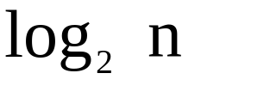
Advantage:
  sorting is avoided
Disadvantage:
  balance problem
A
B
C
D
E
F

Slide 7
AVL-tree
An AVL tree is a binary search tree such that the height of the two subtrees at any vertex differ by at most one
Advantage
  height-balanced: an AVL-tree of height h has N vertices, where
  updates: O(log N)
Example
2

Slide 8
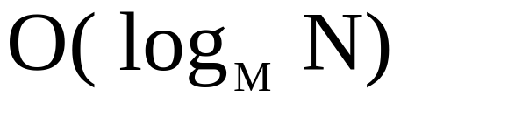
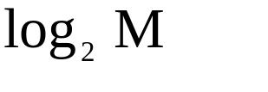
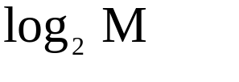
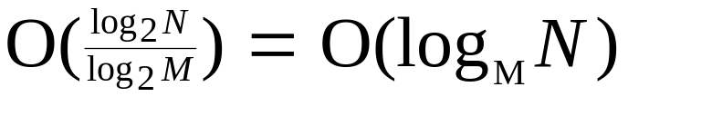
Paged Binary Search Tree
(M-ary search tree)
The basic idea
  a balanced M-ary search tree such that both search and maintenance can be done at
  place a vertex and its descendants down to a fixed level ( ) into a single page (cluster) such that the search on the whole subtree of levels can be done in one disk access. Therefore, the average search and maintenance can be done at

Slide 9
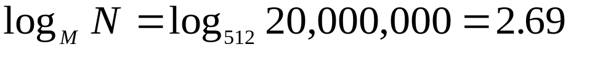
Paged Binary Search Tree
Perspective
  Assume N = 20,000,000 records,
  M = 512 records.
  Then
  This implies that it takes three disk accesses to retrieve a record from a file of 20 million records.
Difficulties
  balancing
  maintenance cost

Slide 10

B-trees
Basic Ideas
  paged binary search tree with m-1 keys per page
  the balance is guaranteed by the bottom-up maintenance technique
    split & promotion for overflow during insertion
    redistribution & concatenation for underflow during deletion

Slide 11

Formal definition of B-tree properties
A B-tree of order m is a paged binary search tree such that
  each page contains a maximum of m-1 keys
  each page, except for the root, contains at least
  a non-leaf page with k keys has k+1 descendants
  all the leaves appear on the same level

Slide 12
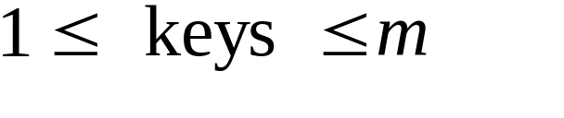
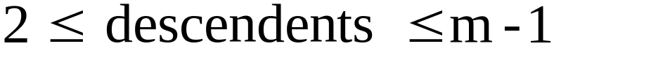
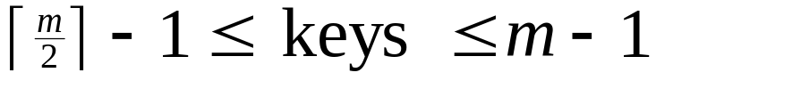
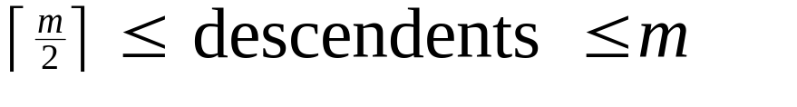
B-tree of order m
Root page
Other pages
Leaf pages
  all at the same level

Slide 13

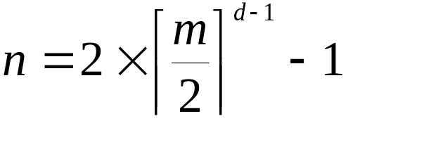
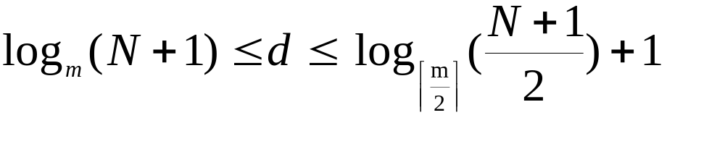
Performance Analysis
B-tree of order m with N keys and d depth
  Best case: maximum number of keys
  Worst case: minimal number of keys
Theorem:

Slide 14
Operations
Insertion
  insert the key into an appropriate leaf page (by search)
  when overflow: split and promotion
    Split the overflow page into two pages
    promote a key into a parent page
  if the promotion in the previous step cause additional overflow, then repeating the split-promotion
Search
  recursively search each page along an appropriate path

Slide 15
Operations
Deletions
  search B-tree to find the key to be deleted
  swap the key with its immediate successor, if the key is not in a leaf page
    (Note only keys in a leaf may be deleted)
  when underflow: redistribution or concatenation
    redistribute keys among an adjacent sibling page, the parent page, and the underflow page if possible ( need a rich sibling)
    otherwise, concatenate with an adjacent page, demoting a key from the parent page to the newly formed page.
  if the demotion cause underflow, repeating the redistribution-concatenation

Slide 16
Example
Construct a B-tree of order 4 that results from loading the following keys in order (at most 3 keys and at least one)
  3, 7, 16, 24, 14, 19, 21, 15, 1, 5, 2, 8, 12, 6

Slide 17
14
5 8
16
1 2 3
6 7
12
15
19 21 24
Now, delete the following keys from the above B-tree
16, 14, 2, 15,

Slide 18
8
5
19
1 3
6 7
12
21 24
This is the result B-tree after a sequence of keys deleted

Slide 19
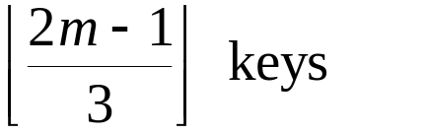
Improvements
Redistribution during insertion
  a way of avoiding, or at least, postponing the creation of a new page by redistributing overflow keys into its sibling pages
  improve space utilization: 67% ---> 86%
B*-trees
  two-to-three split
    distribute all keys in two full pages into three sibling pages evenly
  each page contains at least

Slide 20
Improvements
Virtual B-trees
  B-trees that uses RAM page buffers
  buffer strategies
    keep the root page
    retains the pages of higher levels
    LRU (the Least Recently Uses page is the buffer is replaced by a new page)

Slide 21
Associate of keys and records
  Store the information in the B-tree along with the keys
    once the key is found, no more disk access is required
    reduce the number of keys that can be stored in a page
  Place the information in a separate data file, and store the physical addresses with keys in the B-tree

Slide 22
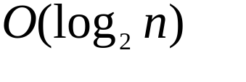
Indexed Sequential Accesses and B+-trees
Primary problem:
  efficient sequential access and indexed search (dual mode applications)
Possible solutions:
  sorted files:
    good for sequential accesses
    unacceptable for indexed search
    maintenance costs too high
  B-trees:
    good for indexed search
    very slow for sequential accesses (tree traversal)
    maintenance costs low
  B+ trees: a file with a B-tree structure + a sequence set

Slide 23
Sequence sets
Arrange the file into blocks
  usually clusters or pages
Records within blocks are sorted
Blocks are logically ordered
  using a linked list
If each block contains b records, then sequential access in N/b disk accesses
Example:
head = 2
1 D, E, F, G 4
2 A, B, C 1
3 J, K, K, M, N -1
4 H, I 3

Slide 24
Maintenance of sequence sets
Goal: keep blocks at least half full
  accommodates variable length records
file updates problems solutions
insertion overflow split w/o promotion
deletion underflow redistribution
concatenation

Slide 25
Other considerations
Choice of block size
  the bigger the better
  restricted by size of ram, buffer, access speed
Index to blocks
  keys of last record in each block
  separator: a shortest string that separates keys in two consecutive blocks

Slide 26
Example
head is B2
B1 camp --- dutton B6
B2 adams --- berne B4
B3 faber --- folk B5
B4 bolen --- cage B1
B5 folks --- gaddis -1
B6 embry --- evans B3
Block # Keys Separators
2 berne bo
4 cage cam
1 dutton e
6 evans f
3 folk folk
5 gaddis

Slide 27
The simple prefix B+ trees
Sequential set + B-tree of index set
Example
e
index set
bo | cam
f | folks
adams --- berne bolen --- cage camp -- dutton embry --- evans faber -- folk folks -- gaddis

Slide 28
Maintenance of B+ trees
Updates are first made to the sequence set and then changes to the index set are made if necessary
  If blocks are split, add a new separator
  If blocks are concatenaed, remove a separator
  If records in the sequence set are redistributed, change the value of the separator

Slide 29
Building a simple prefix B+ tree
There are two approaches
Using insertion procedure
  splitting and redistribution are expensive
Loading
  presort the sequence set
  construct a B-tree of the index set to the sequence set
The size of blocks in the index set is usually the same as that of
the sequence set.

Slide 30
Construct a B+ tree of order 4 from the following sequence of numbers. (For order 4, at most 3 records and at least one)
  18, 26, 24, 134, 16, 78, 4, 69, 324, 13, 1
26
13 18
78
1 4
13 16
18 24
26 69
78 134 324

Slide 31
Difference between B-tree and B+ tree
In the B-tree, the page contains the keys and information (or a pointer to it)
In the B+ tree, the keys and information are contained in the sequence set
For the B+ tree, ordered sequential access is faster
The B+ tree is usually shallower than a B-tree

